Slide 1

with Mrs. Magee
ESOL Parent Communication

Slide 2
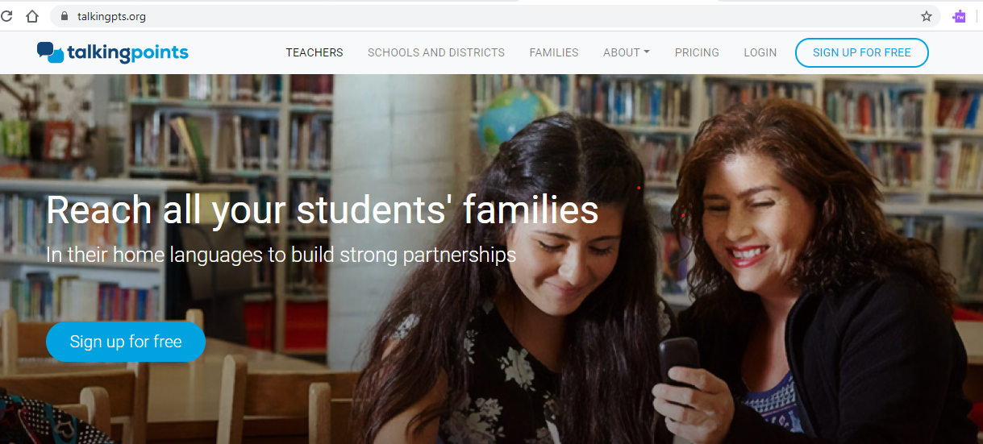
Talking Points

Slide 3

Why Talking Points?
Talking Points is a free resource for teachers and parents.
It can be used on your computer or as an app on your smart phone.
Teachers create a login & password. Parents get texts on their phone or can get the Talking Points App.
Teachers add their student’s name and parent’s cell phone number and home language.
Teachers can communicate with their parents by typing a message in English and sending it to their parents.
When the parents receive the teacher’s message, it will be translated in their home/native language.
The parent can respond to the teacher by typing a message in their home/native language and sending it back to their teacher.
The teacher will receive the parent’s return response in English.

Slide 4
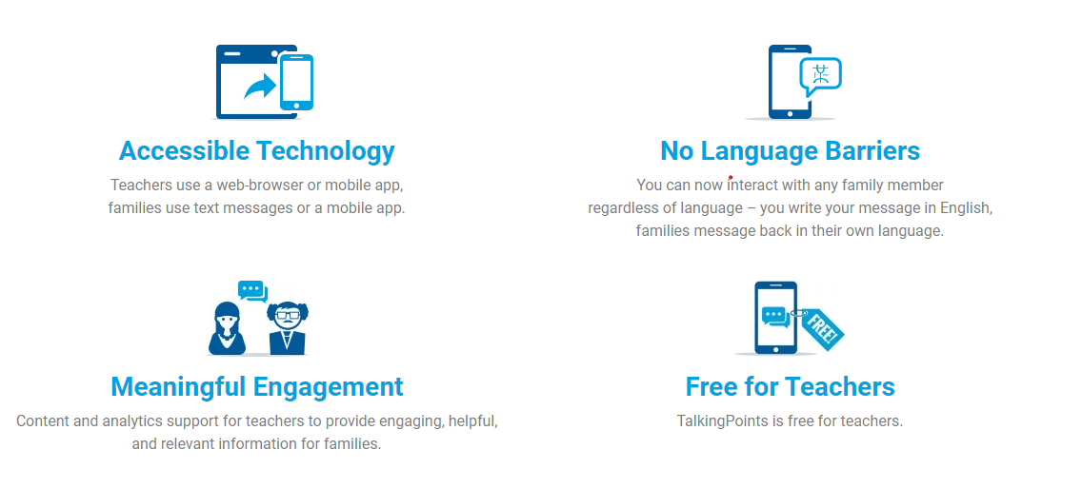
www.talkingpoints.org

Slide 5
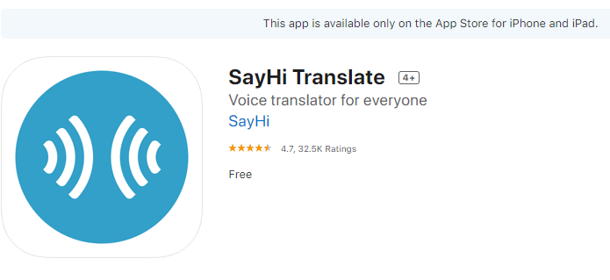
SayHi is a voice translator app

Slide 6
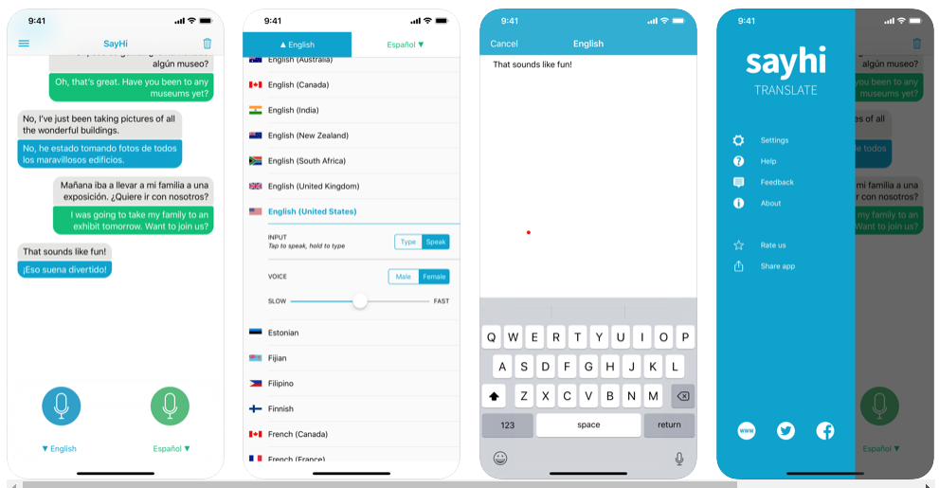
This is my favorite voice translator. I use it with my ESOL students and parents.

Slide 7
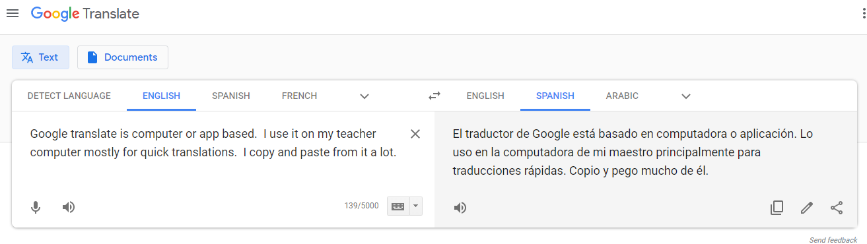
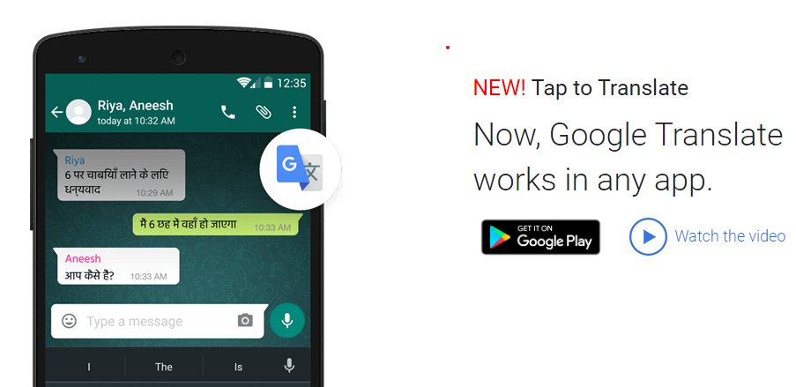
Google Translate

Slide 8

RTT Translation Services/ELSA Lite
ELSA lite is a live interpretation solution that provides immediate communication in 180 languages. ELSA gives us the freedom to communicate with Non-English speakers via cell phone or land line.

Slide 9
RTT Translation Services/ELSA Lite
Your ESOL teacher has the ELSA Lite app on her personal cell phone and is available to help you when you need to speak with a parent. (IEP meetings, RTI meetings, Conferences, etc.)
ELSA Lite is also available through your ESOL teacher and administrator via land line.
ALL TEACHERS can use this service just by contacting the ESOL teacher or speaking with your school administrator. (This is available to you even if you don’t have ESOL students.)
Your ESOL teacher or school administrator calls ELSA Lite and requests your desired language. A live person will come on the call and translate for you. The speaker phone works great on a land line when you are having face-to-face conferences.
Three way conference calls can be made between the teacher, parent, and translator. I use it ALL the time.
Mrs. Hall can use this app from her home if needed during the Covid-19 crisis.

Slide 10
Let me know your Language needs.
I want you to know that I am very glad to help the teachers at Nebo and Panter with our non-English speaking parents and students. (Even if they are not in ESOL.)
Please let me know how I can help you.
Melanie Hall
mhall@Paulding.k12.ga.us

